Slide 1
Chapter 2 Frequency Distributions

Slide 2
Frequency Distribution
A table reporting the number of observations falling into each category of the variable

Slide 3
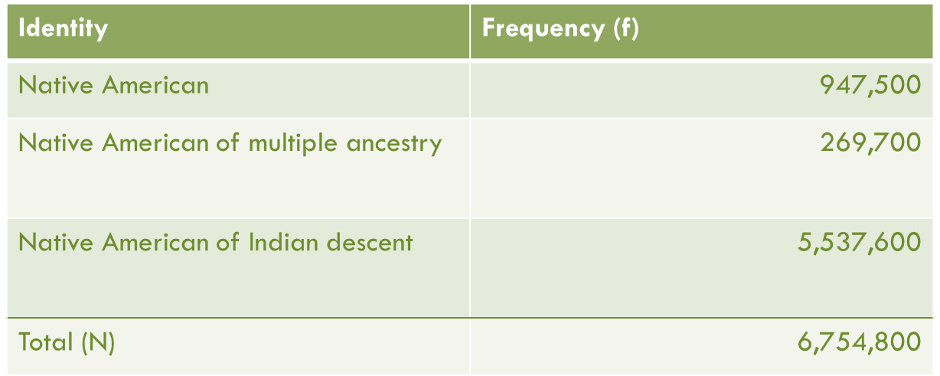
Frequency Distribution

Slide 4
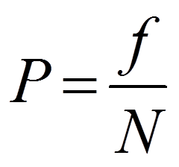
Proportions
A relative frequency obtained by dividing the frequency in each category by the total number of cases

Slide 5
Exercise: Calculate Proportions

Slide 6

Percentage
A relative frequency obtained by dividing the frequency in each category by the total number of cases and multiplying by 100
A proportion multiplied by 100

Slide 7
Exercise: Calculate Percentages

Slide 8
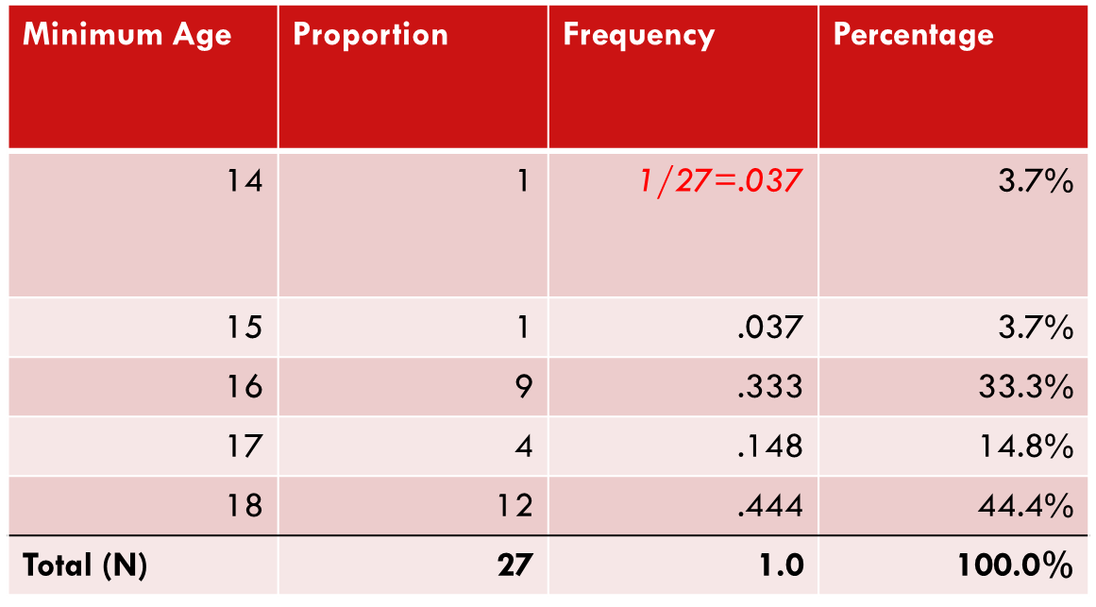
Proportions and Percentages

Slide 9
Percentage Distributions
A table showing the percentage of observations falling into each category of the variable

Slide 10
Percentage Distributions
Minimum Age | Frequency | Proportion | Percentage
14 | 1 | 1/27 = .037 | 3.7%
15 | 1 | .037 | 3.7%
16 | 9 | .333 | 33.3%
17 | 4 | .148 | 14.8%
18 | 12 | .444 | 44.4%
Total (N) | 27 | 1.0 | 100.0%

Slide 11
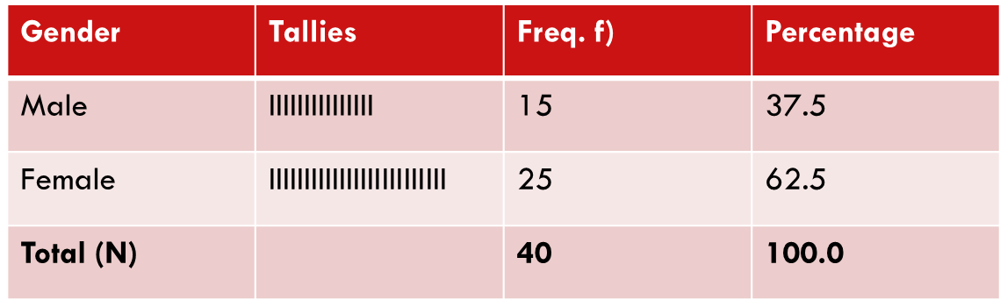
Frequency Distributions
Nominal Variables

Slide 12
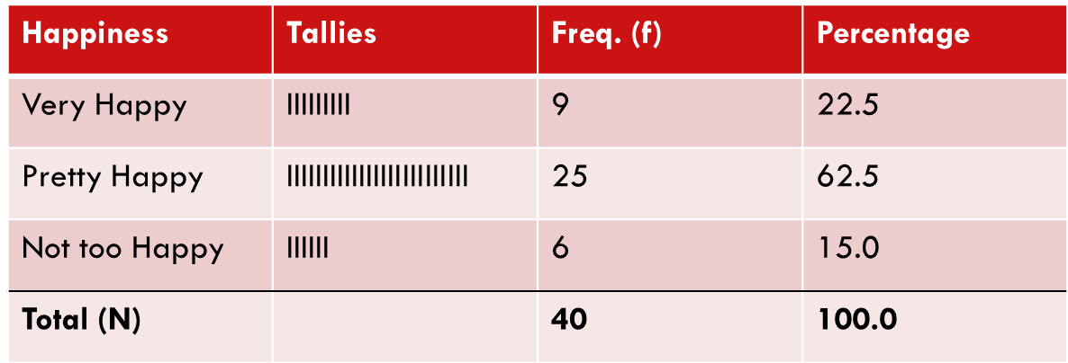
Frequency Distributions
Ordinal Variables

Slide 13
Exercise: Ordinal Frequency Distributions
Construct ordinal frequency distribution for grade level of the students in this class
Freshmen
Sophomores
Juniors
Seniors (or greater)

Slide 14
Cumulative Distributions
Cumulative frequency distribution
A distribution showing the frequency at or below each category of the variable
Cumulative percentage distribution
A distribution showing the percentage at or below each category of the variable

Slide 15
Cumulative Frequency Distribution
Minimum Age | Freq. (f) | Percentage (%) | Cumulative Frequency (Cf)
14 | 1 | 3.7 | 1
15 | 1 | 3.7 | 2
16 | 9 | 33.3 | 11
17 | 4 | 14.8 | 15
18 | 12 | 44.4 | 27
Total (N) | 27 | 100.1*
*Doesn’t total to 100% due to rounding

Slide 16
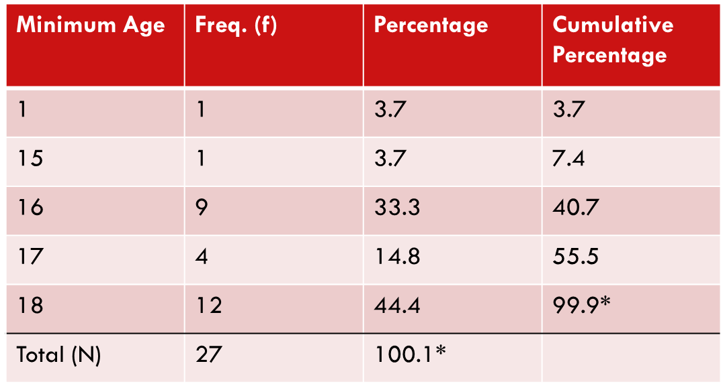
Cumulative Percentage Distribution

Slide 17
Rate
A number obtained by dividing the number of actual occurrences in a given time period by the number of possible occurrences

Slide 18
Exercise: Determine the 2014 Poverty Rate
Number of people in poverty in 2014 (actual occurrences) divided by the total population in 2014 (possible occurrences)
Poverty Population
2013: 45,565,000
2014: 46,247,000
Total Population
2013: 307,654,000
2014: 308,456,000
Notes:
=.15 or 15%

Slide 19
Reading Statistical Tables
What is the source of the table?
How many variables are presented? What are their names?
What is represented by the numbers presented in the first column? In the second column?

Slide 20
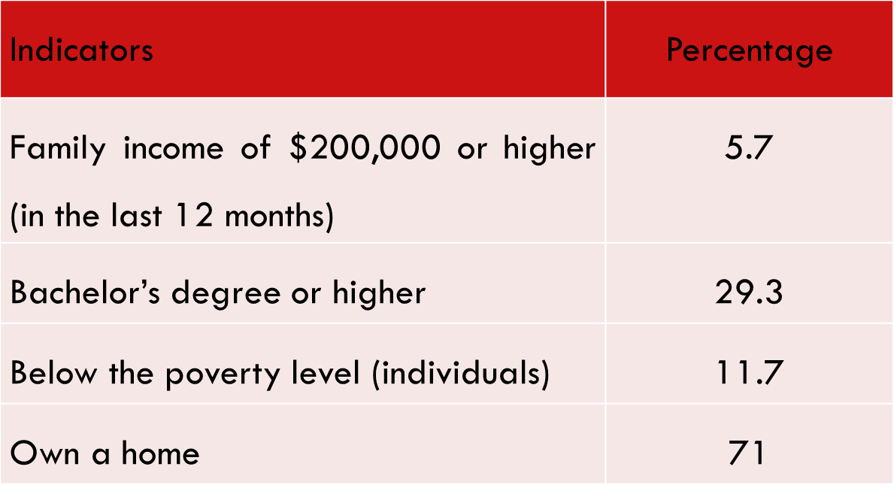
Example: Reading Statistical Tables
Table 2.16 Selected Economic and Social Indicators for Whites, 2009
Source: U.S. Census Bureau, 2012 Statistical Abstract of the United States, Table 36

Slide 21
Key Terms
Cumulative Frequency Distribution
Cumulative Percentage Distribution
Frequency Distribution
Percentage
Percentage Distribution
Proportion
Rate

